Slide 1

CS 584 Machine Learning
Week 8
March 6, 2019

Slide 2

Week 8 Agenda: Learner Evaluation and Comparison
A common practice
A few popular metrics
An example
Chapter 19 of the Machine Learning book

Slide 3
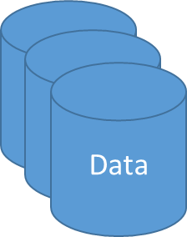
Machine Learning Life Cycle
Ask the Question
Specify What to Learn
Retrieve Data
Train Algorithms
Deploy Algorithm
Collect Feedback
Use Feedback
Important Question
How can I be sure that a particular machine learning algorithm actually works in deployment?
Define “Sure”
Define “Actually Works”
Define “Deployment”

Slide 4
Surety in Deployment
Deployment means you are going to apply the results of the machine learning algorithm (a.k.a. the model) on a different data, in a different environment, at a future time, or by someone else.
Since there may be many things, foreseeable or not, that are out of my control in deployment, we may want to simulate or practice a deployment while things are still under my control.
Let us revisit the two R concepts: Reproducibility and Replicability.

Slide 5
Reproducibility
If we start from the original data, use the same algorithms, execute the same tasks on the same or compatible machine, the machine learning activity will reproduce the same results (within the machine precisions) and arrive at the same conclusions.
If the expected results cannot be reproduced, this indicates there are some unexplained (intentional or random) interactions among the data, the algorithm, and the machine.
Common causes are uninitialized variables in the codes or incomplete or inaccurate documentation of the activity.

Slide 6
Replicability
If a researcher runs the machine learning activity (i.e., use the same algorithms, execute the same tasks) using a different data on some compatible machine, the researcher is able to obtain results that lead to the same conclusions (e.g., the list of selected features, the distribution of the predicted outcomes).
If the expected conclusions cannot be replicated, this indicates there are some design flaws in the tasks. For example, some correlations among the features are not accounted for, the algorithms need further debugging, or different algorithms should be considered.

Slide 7
Surety in Deployment
We will have more confidence in the machine learning algorithm if we can replicate the results or conclusions by applying the algorithm on different data.
Be Objective in Deployment
For example, a game contester cannot be the judge!
Anticipate for the Unexpected in Deployment
A car that runs most smoothly inside a wind tunnel may not perform while driving through the winter Chicago traffic (with potholes)!

Slide 8
A Common Practice
A common practice is to separate the original observations into two, or occasionally three, partitions.
Randomly select a big majority of the observations to form the Training partition
Randomly select another portion of the remaining observations to form the Testing partition
The occasional third dataset which we called the Hold-Out partition consists of the leftover observations

Slide 9
Partition Data
Training Partition
Use for training or building the model
Find the best model parameters, weights, and structure using this partition
Testing Partition
Use for assessing the performance of a model
Use for comparing performance among models
Play the role of a “future data”
Hold-Out Partition
Use to obtain a final, unbiased estimate of the generalization error of the model
For example, benchmark data in the financial industry that measures model performance across time, regions, etc.

Slide 10
Partition Data
Unless we are required to report model performance on a benchmark dataset, we usually do not need the Hold-Out partition
No need for the Hold-Out Partition
Typical Allocation: Training (70%), Testing (30%), Hold-Out (0%)
Small or Noisy Data: Training (80%), Testing (20%), Hold-Out (0%)
Large or Good Data: Training (60%), Testing (40%), Hold-Out (0%)
Need an objective measure of errors on the Hold-Out Partition
Fairly Large Data: Training (50%), Testing (30%), Hold-Out (20%)

Slide 11
Partition Data by a Pre-Defined Group
Partition by chronological variables
Build time-sensitive models (e.g., customer sentiment models, insurance premium models) based on historical data from 2010 to 2014
Then compare models based on “future” data from 2015 to 2016
Partition by geographical variables
Build marketing campaign models based on the US coastal states
Then compare models based on the US inland states

Slide 12
Partition Data by Statistical Sampling
Simple Random Sampling (SRS)
Stratified Simple Random Sampling

Slide 13
Simple Random Sampling
If K observations are to be selected from a pool of N observations, then any collection of K of N observations will have the same chance to be selected.
Observations are sampled without replacement (i.e., once an observation is selected, it cannot be selected again)
Suppose I need to sample 3 observations without replacement from these 5 values: (1,2,3,4,5). Here, N = 5 and K = 3.
There are C(5,3) = 5! / (3! *2!) = 10 possible samples: (1,2,3), (1,2,4), (1,2,5), (1,3,4), (1,3,5), (1,4,5), (2,3,4), (2,3,5), (2,4,5), (3,4,5).
SRS says that each of these 10 possible samples will have an equal chance (i.e., 1/10) to be selected.

Slide 14
Stratified Simple Random Sampling
The observations are first separated into disjoint groups (i.e., strata) defined by the strata variables, then the observations in each group are selected by simple random sampling
The sample size in each stratum is proportional to the size of the stratum
Suppose the 5 values: (1,2,3,4,5) are actually divided into two groups: {A: 1,2} and {B: 3,4,5}. I need to sample 3 observations, one from A and two from B.
Two possible SRS samples from A: (1) and (2). Three possible samples from B: (3,4), (3,5), and (4,5).
Stratified samples are: (1,3,4), (1,3,5), (1,4,5), (2,3,4), (2,3,5), and (2,4,5) by taking one SRS sample from each group and combine them.

Slide 15
Python Function for Partitioning Data
Function:
sklearn.model_selection.train_test_split (*arrays, **options)
Description:
Split arrays or matrices into the random train and test subsets
Reference:
http://scikit-learn.org/stable/modules/generated/sklearn.model_selection.train_test_split.html#sklearn.model_selection.train_test_split

Slide 16
Simple Random Sampling
import pandas
from sklearn.model_selection import train_test_split
hmeq = pandas.read_csv('C:\\Users\\minlam\\Documents\\IIT\\Machine Learning\\Data\\hmeq.csv’, delimiter=',')
hmeq_train, hmeq_test = train_test_split(hmeq, test_size = 0.3, random_state = 60616)
Week 8 Partition Data.py

Slide 17
Simple Random Sampling
test_size = 0.3
Assign 30% of observations to the Testing partition
Assign 100% - 30% = 70% observations to the Training partition
random_state = 60616
The random seed is 60616
Original number of observations in hmeq.csv is 5,960
Training partition has 5,960 * 70% = 4,172 observations
Testing partition has 5,960 * 30% = 1,788 observations

Slide 18
Simple Random Sampling
Look at the distribution of the target variable BAD in the training and the testing partitions.
hmeq_train.groupby('BAD').size() / hmeq_train.shape[0]
BAD
0 0.795542
1 0.204458
hmeq_test.groupby('BAD').size() / hmeq_test.shape[0]
BAD
0 0.812081
1 0.187919

Slide 19
Simple Random Sampling
The probability that an observation will go to either partition is
Prob(Training) = 0.7
Prob(Testing) = 0.3
Given an observation in the Training partition, then BAD is
Prob(BAD=0 | Training) = 0.795542
Prob(BAD=1 | Training) = 0.204458
Given an observation in the Testing partition, then BAD is
Prob(BAD=0 | Testing) = 0.812081
Prob(BAD=1 | Testing) = 0.187919

Slide 20
Simple Random Sampling
The posterior probability
Prob(Training | BAD=0) = Prob(BAD=0 | Training) * Prob(Training) / (Prob(BAD=0 | Training) * Prob(Training) + Prob(BAD=0 | Testing) * Prob(Testing)) = 0.795542 * 0.7 / (0.795542 * 0.7 + 0.812081 * 0.3) = 0.695661
Prob(Testing | BAD=0) = Prob(BAD=0 | Testing) * Prob(Testing) / (Prob(BAD=0 | Training) * Prob(Training) + Prob(BAD=0 | Testing) * Prob(Testing)) = 0.812081 * 0.3 / (0.795542 * 0.7 + 0.812081 * 0.3) = 0.304339

Slide 21
Simple Random Sampling
The posterior probability
Prob(Training | BAD=1) = Prob(BAD=1 | Training) * Prob(Training) / (Prob(BAD=1 | Training) * Prob(Training) + Prob(BAD=1 | Testing) * Prob(Testing)) = 0.204458 * 0.7 / (0.204458 * 0.7 + 0.187919 * 0.3) = 0.717410
Prob(Testing | BAD=0) = Prob(BAD=0 | Testing) * Prob(Testing) / (Prob(BAD=0 | Training) * Prob(Training) + Prob(BAD=0 | Testing) * Prob(Testing)) = 0.187919 * 0.3 / (0.204458 * 0.7 + 0.187919 * 0.3) = 0.282590

Slide 22
Simple Random Sampling
BAD = 1 observations have slightly higher chance to be assigned to the Training partition, but lower chance to the Testing partition
Posterior Probabilities
Prob(Training | BAD=0) = 0.695661
Prob(Training | BAD=1) = 0.717410
Prob(Testing | BAD=0) = 0.304339
Prob(Testing | BAD=1) = 0.282590
For a model that is accurately trained to predict BAD=1 observations in the training partition, it is slightly unfair to apply that model to the testing partition.
For a model that is accurately trained to predict BAD=0 observations, the model already has the advantage when applied to the testing partition.

Slide 23
Stratified Simple Random Sampling
print(hmeq.groupby('BAD').size() / hmeq.shape[0])
BAD
0 0.800503
1 0.199497
BAD = 0 in 80.0503% of the original observations
BAD = 1 in 19.9497% of the original observations
Stratified Sampling aims to maintain this distribution in both the Training and the Testing partitions.

Slide 24
Stratified SRS
hmeq_train, hmeq_test = train_test_split(hmeq, test_size = 0.3, random_state = 60616, stratify = hmeq['BAD'])
print('Number of Observations in Training = ', hmeq_train.shape[0])
print('Number of Observations in Testing = ', hmeq_test.shape[0])
Number of Observations in Training = 4172
Number of Observations in Testing = 1788
Stratified sampling still assigns 30% of 5,960 (which is 1,788) observations to the Testing partition. The remaining 70% (i.e., 4,172) observations go to the Training partition.

Slide 25
Stratified SRS
print(hmeq_train.groupby('BAD').size() / hmeq_train.shape[0])
BAD
0 0.800575
1 0.199425
print(hmeq_test.groupby('BAD').size() / hmeq_test.shape[0])
BAD
0 0.800336
1 0.199664
The distribution of BAD in each partition is very similar to that of the original data.
BAD = 0 in 0.800503 of the original observations
BAD = 1 in 0.199497 of the original observations

Slide 26
Stratified SRS
BAD = 1 observations have practically equal chance to be assigned to the Training or the Testing partition. The difference is 0.000315.
Posterior Probabilities
Prob(Training | BAD=0) = 0.700063
Prob(Training | BAD=1) = 0.699748
Prob(Testing | BAD=0) = 0.299937
Prob(Testing | BAD=1) = 0.300252
For a model that is accurately trained to predict BAD=1 observations, it is fair to apply that model to the testing partition.
For a model that is accurately trained to predict BAD=0 observations, the model does not have any particular advantage when applied to the testing partition.

Slide 27
Simple Random vs Stratified
For analyses that have a categorical target variable, I recommend using Stratified Sampling to create partitions.
Pros: distribution of the target variable is maintained across partitions
Cons: may be a challenge for rare event target variable where strata of very uneven sizes are created, e.g., only 5 events in 1000 observation, 70% training may get 3 events (3/700 = 0.004) while the 30% testing gets 2 events (2/300 = 0.007), both event probabilities are different from the 5/1000 = 0.005.
For analyses that have a continuous target variable, I recommend using Simple Random Sampling to create partitions.
Pros: no need to specify a stratum variable when no obvious choices exist
Cons: nothing guaranteed about the histogram of the target across partitions

Slide 28
Metrics for Evaluation and Comparison
Statistical Metrics:
Originated from statistical literature
Interval Target: Root Mean Squared Errors, R-squared
Categorical Target: Entropy and Gini statistics
Information Theory: Akaike's Information Criterion (AIC) and Bayesian Information Criterion (BIC)
Classification Metrics:
Originated from engineering literature for binary target
Receiver Operating Characteristic (ROC) charts and corresponding area under the curve, Misclassification Rate, Root Mean Squared Errors
Data Mining Metrics:
Originated from direct marketing to evaluate campaign effectiveness for the target market segment
Lift and Gain measures

Slide 29
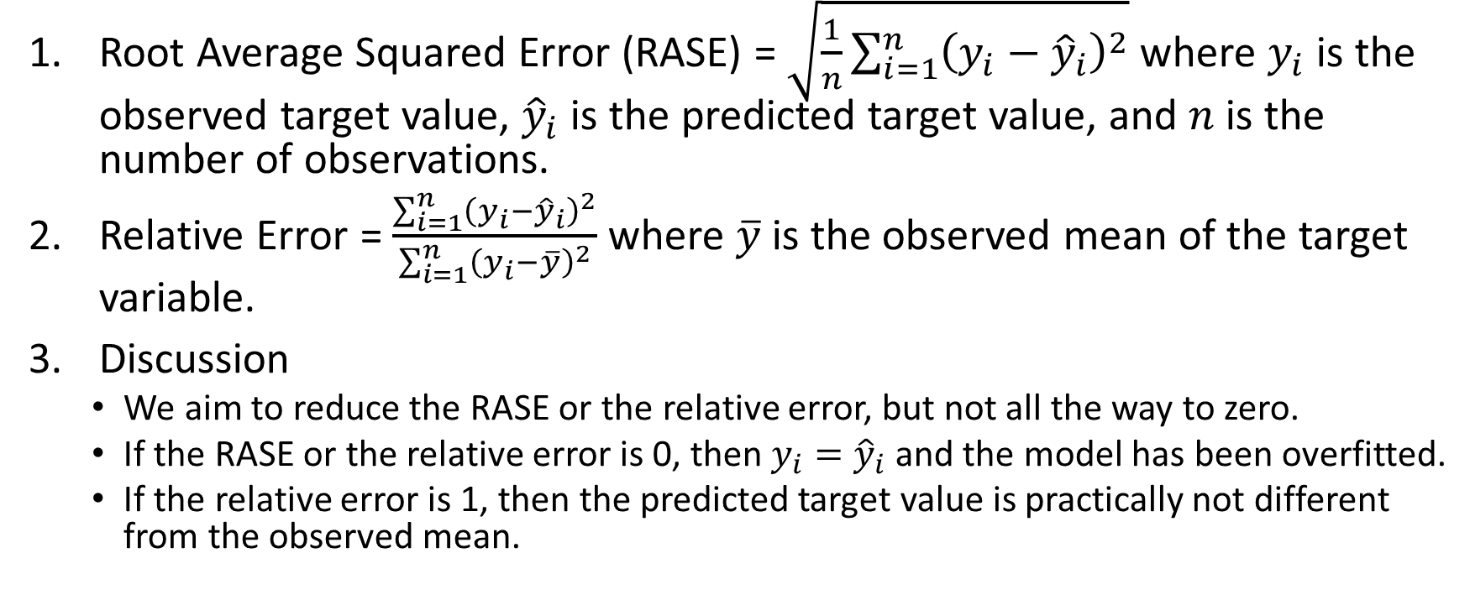
Particular Metrics for Interval Target
Root Average Squared Error (RASE) = $\sqrt{\frac{1}{n}\sum_{i=1}^{n}{{\left(y_{i}−{\hat{y}}_{i}\right)}^{2}}}$ where $y_{i}$ is the observed target value, ${\hat{y}}_{i}$ is the predicted target value, and $n$ is the number of observations.
Relative Error = $\frac{\sum_{i=1}^{n}{{\left(y_{i}−{\hat{y}}_{i}\right)}^{2}}}{\sum_{i=1}^{n}{{\left(y_{i}−\overline{y}\right)}^{2}}}$ where $\overline{y}$ is the observed mean of the target variable.
Discussion
We aim to reduce the RASE or the relative error, but not all the way to zero.
If the RASE or the relative error is 0, then $y_{i}={\hat{y}}_{i}$ and the model has been overfitted.
If the relative error is 1, then the predicted target value is practically not different from the observed mean.

Slide 30
Particular Metrics for Binary Target
We prefer model comparison criteria that are:
Numeric metrics with known ranges (e.g., between 0 and 1)
Calculated using only the predicted probabilities and the occurrence of the event (i.e., Event and Non-Event)
Introduce three metrics:
Area Under Curve (of Receiver Operating Characteristics)
Root Averaged Squared Error
Misclassification Rate

Slide 31
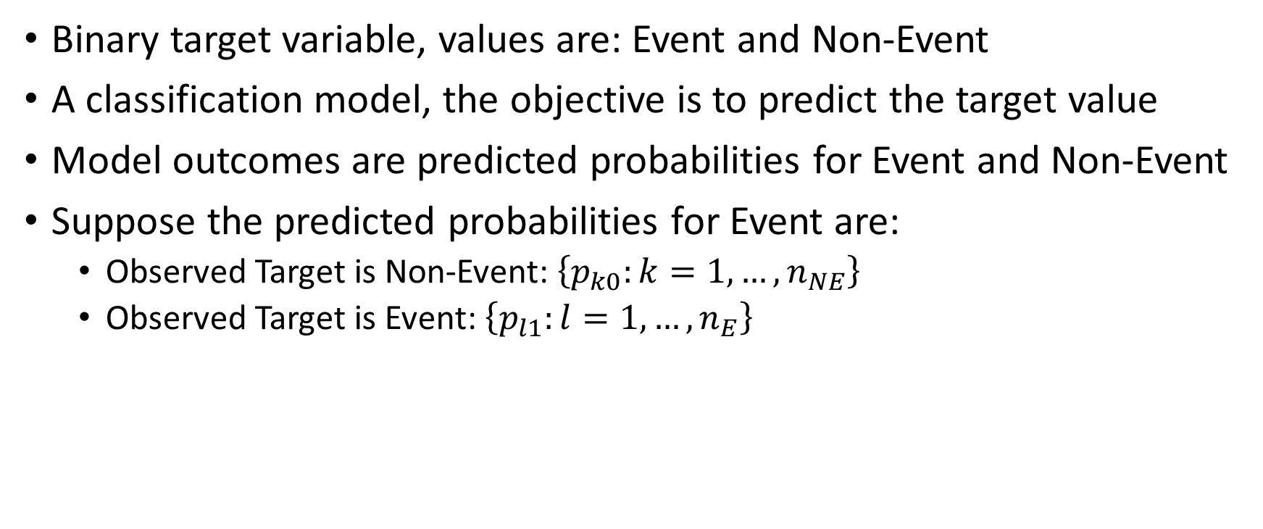
Predicted Probabilities
Binary target variable, values are: Event and Non-Event
A classification model, the objective is to predict the target value
Model outcomes are predicted probabilities for Event and Non-Event
Suppose the predicted probabilities for Event are:
Observed Target is Non-Event: $\left\{p_{k0}:k=1,…, n_{NE}\right\}$
Observed Target is Event: $\left\{p_{l1}:l=1,…, n_{E}\right\}$

Slide 32
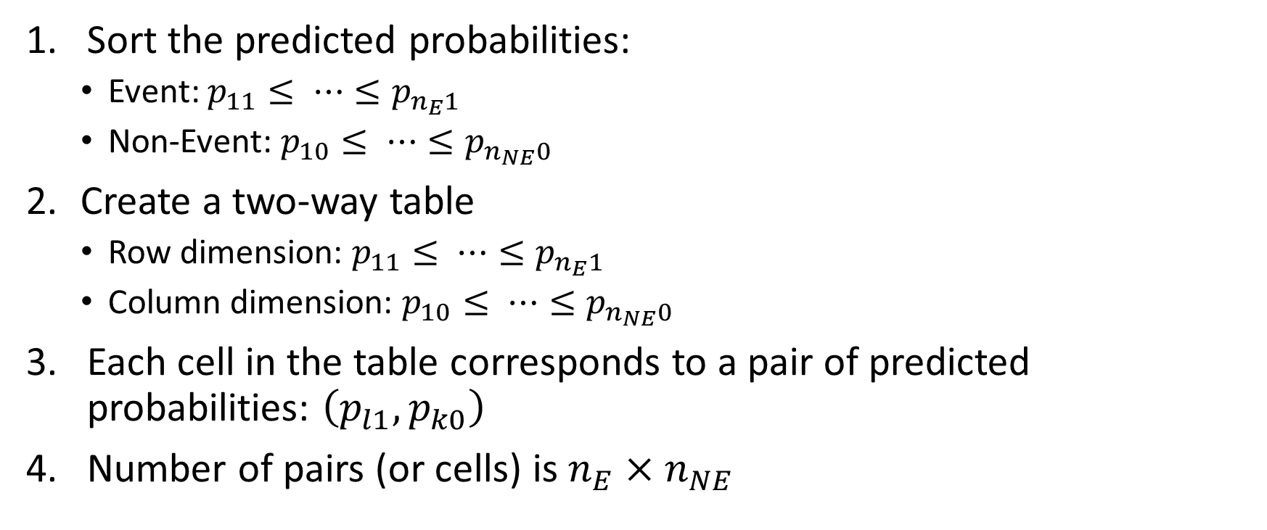
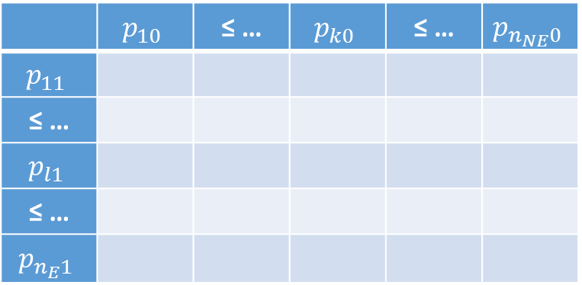
Area Under Curve (AUC)
Sort the predicted probabilities:
Event: $p_{11}≤ ⋯≤p_{n_{E}1}$
Non-Event: $p_{10}≤ ⋯≤p_{n_{NE}0}$
Create a two-way table
Row dimension: $p_{11}≤ ⋯≤p_{n_{E}1}$
Column dimension: $p_{10}≤ ⋯≤p_{n_{NE}0}$
Each cell in the table corresponds to a pair of predicted probabilities: $\left(p_{l1},p_{k0}\right)$
Number of pairs (or cells) is $n_{E}×n_{NE}$
 | $$p_{10}$$ | ≤ … | $$p_{k0}$$ | ≤ … | $$p_{n_{NE}0}$$
$$p_{11}$$
≤ …
$$p_{l1}$$
≤ …
$$p_{n_{E}1}$$

Slide 33
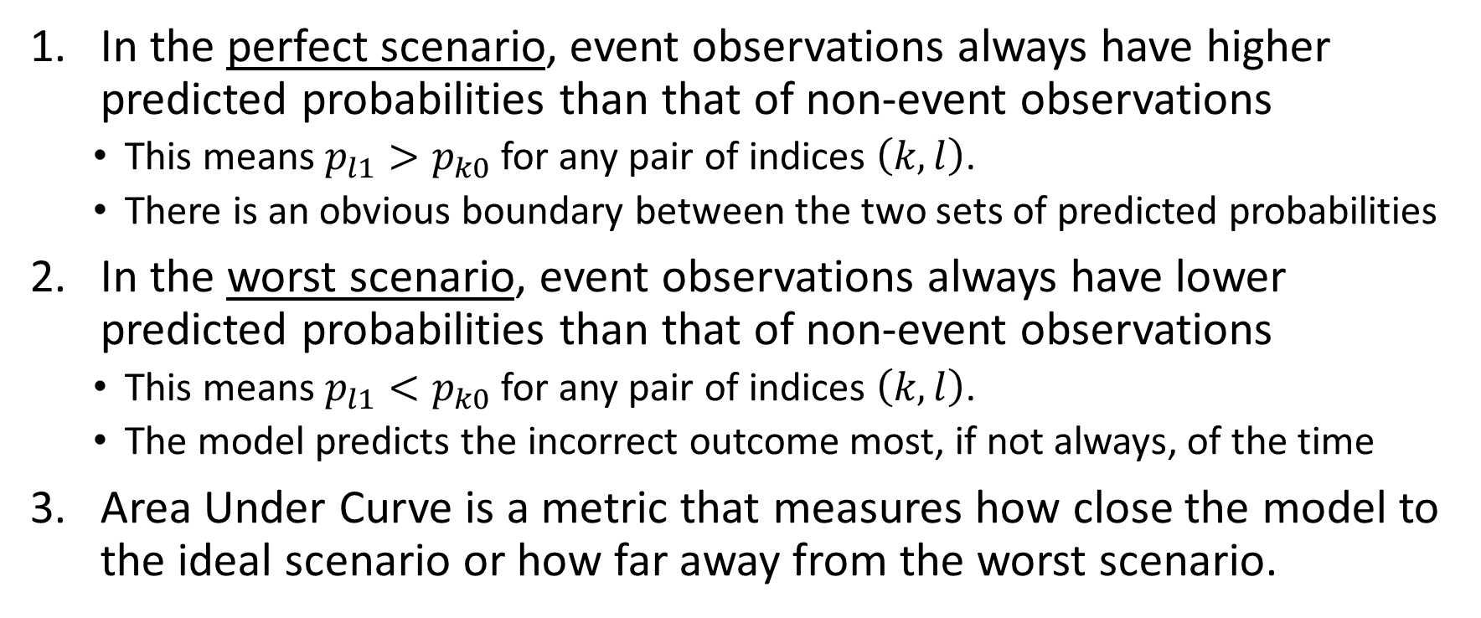
Area Under Curve (AUC)
In the perfect scenario, event observations always have higher predicted probabilities than that of non-event observations
This means $p_{l1}>p_{k0}$ for any pair of indices $\left(k,l\right)$.
There is an obvious boundary between the two sets of predicted probabilities
In the worst scenario, event observations always have lower predicted probabilities than that of non-event observations
This means $p_{l1}<p_{k0}$ for any pair of indices $\left(k,l\right)$.
The model predicts the incorrect outcome most, if not always, of the time
Area Under Curve is a metric that measures how close the model to the ideal scenario or how far away from the worst scenario.

Slide 34
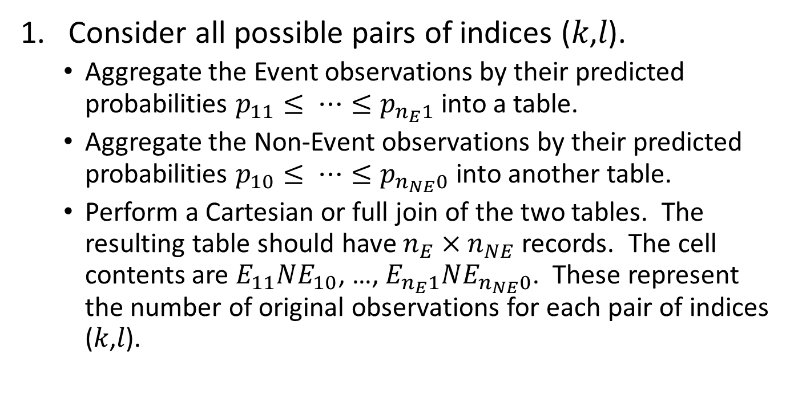
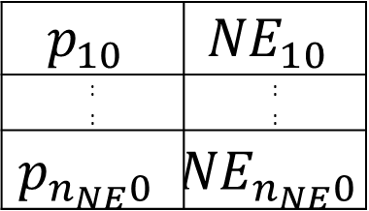
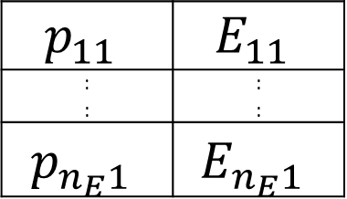
Area Under Curve (AUC): Algorithm
$$p_{11}$$ | $$E_{11}$$
: : | : :
$$p_{n_{E}1}$$ | $$E_{n_{E}1}$$
Consider all possible pairs of indices (𝑘,𝑙).
Aggregate the Event observations by their predicted probabilities $p_{11}≤ ⋯≤p_{n_{E}1}$ into a table.
Aggregate the Non-Event observations by their predicted probabilities $p_{10}≤ ⋯≤p_{n_{NE}0}$ into another table.
Perform a Cartesian or full join of the two tables. The resulting table should have $n_{E}×n_{NE}$ records. The cell contents are $E_{11}{NE}_{10}$, …, $E_{n_{E}1}{NE}_{n_{NE}0}$. These represent the number of original observations for each pair of indices (𝑘,𝑙).
$$p_{10}$$ | $${NE}_{10}$$
: : | : :
$$p_{n_{NE}0}$$ | $${NE}_{n_{NE}0}$$

Slide 35
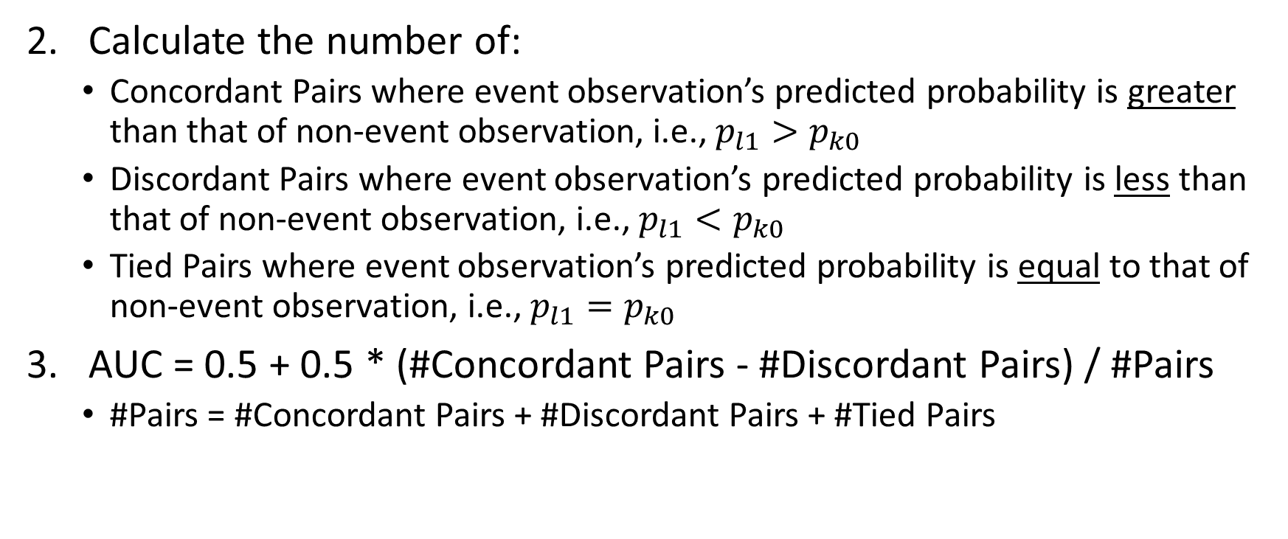
Area Under Curve (AUC): Algorithm
Calculate the number of:
Concordant Pairs where event observation’s predicted probability is greater than that of non-event observation, i.e., $p_{l1}>p_{k0}$
Discordant Pairs where event observation’s predicted probability is less than that of non-event observation, i.e., $p_{l1}<p_{k0}$
Tied Pairs where event observation’s predicted probability is equal to that of non-event observation, i.e., $p_{l1}=p_{k0}$
AUC = 0.5 + 0.5 * (#Concordant Pairs - #Discordant Pairs) / #Pairs
#Pairs = #Concordant Pairs + #Discordant Pairs + #Tied Pairs

Slide 36
Area Under Curve (AUC): Example
The target is a binary variable whose values are Event and Non-Event.
The following table contains the observed target value and the predicted event probabilities.
Observed Target Value | Predicted Event Probability
Event | 0.9
Non-Event | 0.5
Non-Event | 0.3
Event | 0.7
Event | 0.3
Non-Event | 0.8
Event | 0.4
Non-Event | 0.2
Event | 1.0
Event | 0.5
Non-Event | 0.3

Slide 37
Area Under Curve (AUC): Example
Group the predicted probabilities into Event and Non-Event groups
Sort the predicted probabilities in ascending order within each group
Observed Target Value | Predicted Event Probability
Event | 0.3
Event | 0.4
Event | 0.5
Event | 0.7
Event | 0.9
Event | 1.0
Non-Event | 0.2
Non-Event | 0.3
Non-Event | 0.3
Non-Event | 0.5
Non-Event | 0.8
Notice the ties?

Slide 38
Area Under Curve (AUC): Example
Count the numbers of Concordant (C), Discordant (D), and Tied (T) pairs
 |  | Non-Event
 |  | 0.2 | 0.3 | 0.3 | 0.5 | 0.8
Event | 0.3 | C | T | T | D | D
 | 0.4 | C | C | C | D | D
 | 0.5 | C | C | C | T | D
 | 0.7 | C | C | C | C | D
 | 0.9 | C | C | C | C | C
 | 1 | C | C | C | C | C

Slide 39
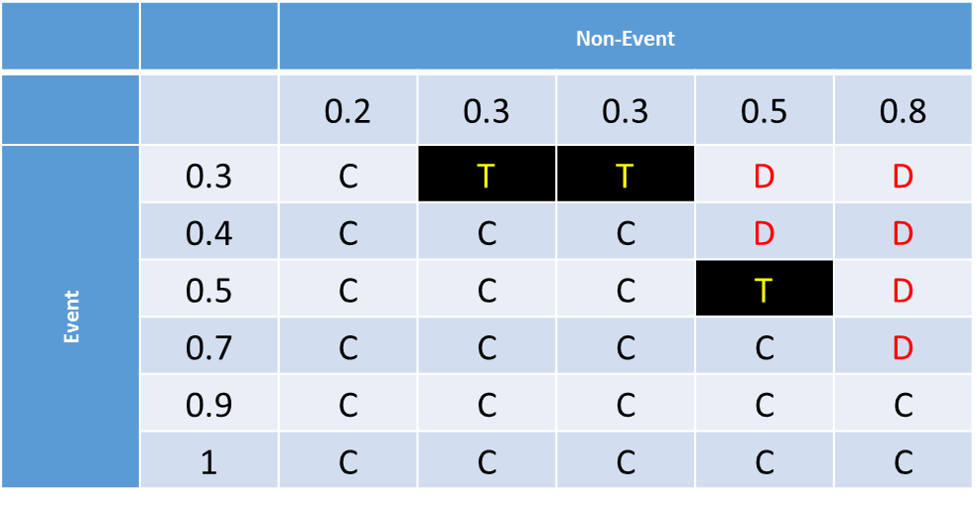
Area Under Curve (AUC): Example
Number of pairs = 6 x 5 = 30
Number of concordant (C) pairs is 21
Number of discordant (D) pairs is 6
Number of ties (T) pairs is 3
The Area Under Curve statistic is: 0.5 + 0.5 x (21 – 6) / 30 = 0.5 + 0.5 x 0.5 = 0.75

Slide 40
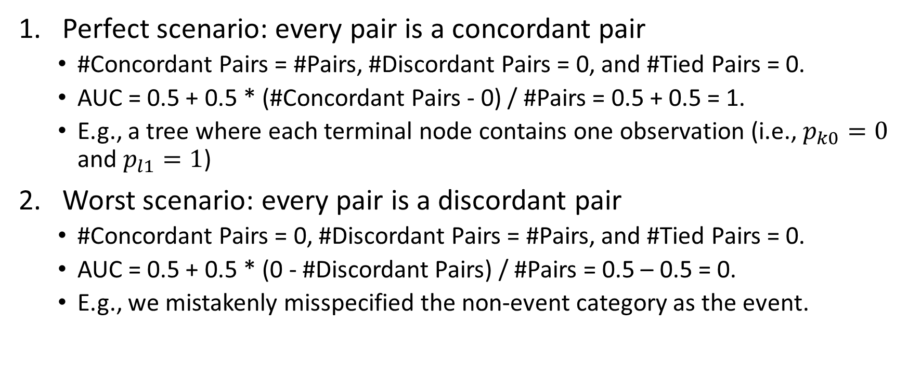
Area Under Curve (AUC)
Perfect scenario: every pair is a concordant pair
#Concordant Pairs = #Pairs, #Discordant Pairs = 0, and #Tied Pairs = 0.
AUC = 0.5 + 0.5 * (#Concordant Pairs - 0) / #Pairs = 0.5 + 0.5 = 1.
E.g., a tree where each terminal node contains one observation (i.e., $p_{k0}=0$ and $p_{l1}=1$)
Worst scenario: every pair is a discordant pair
#Concordant Pairs = 0, #Discordant Pairs = #Pairs, and #Tied Pairs = 0.
AUC = 0.5 + 0.5 * (0 - #Discordant Pairs) / #Pairs = 0.5 – 0.5 = 0.
E.g., we mistakenly misspecified the non-event category as the event.

Slide 41
Area Under Curve (AUC)
Inconclusive Scenario
Either every pair is a tied pair, AUC = 0.5 + 0.5 * (0 – 0) / #Pairs = 0.5
Or #Concordant Pairs = #Discordant Pairs, AUC = 0.5 + 0.5 * 0 = 0.5
E.g., an intercept only model where all predicted probabilities are equal for event and non-event observations.
Acceptable model: AUC > 0.5
Higher the AUC above 0.5, better the model.

Slide 42
Area Under Curve (AUC)
Strength
This method does not require you to subjectively select the threshold that predicts an observation as Event versus Non-Event.
The AUC value is between 0 and 1 and a reference value of 0.5.
Weakness
This method uses only the relative order of predicted probabilities and ignores the actual values.
It does not tell about the distribution of predicted probabilities.
It summarizes the model performance over intervals of probabilities that you may not be too concerned (e.g., mediocre values [0.3, 0.7])

Slide 43
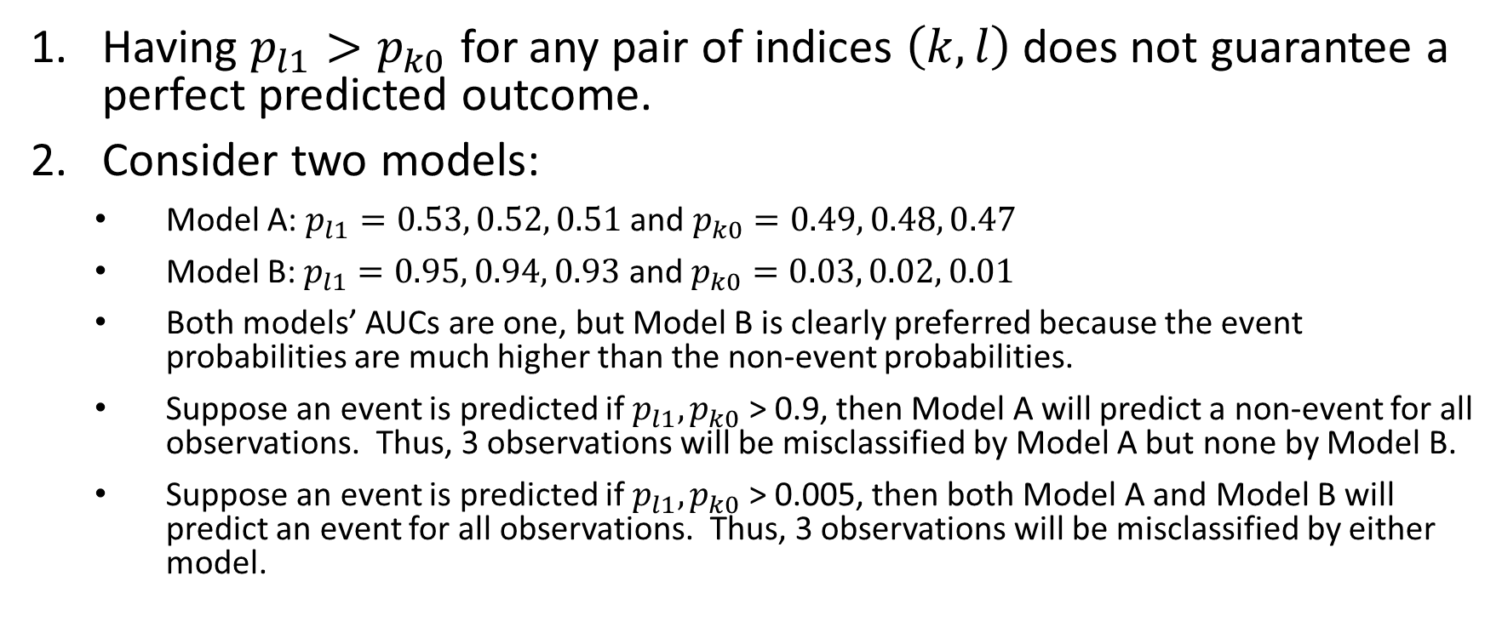
Area Under Curve (AUC)
Having $p_{l1}>p_{k0}$ for any pair of indices $\left(k,l\right)$ does not guarantee a perfect predicted outcome.
Consider two models:
Model A: $p_{l1}=0.53, 0.52, 0.51$ and $p_{k0}=0.49, 0.48, 0.47$
Model B: $p_{l1}=0.95, 0.94, 0.93$ and $p_{k0}=0.03, 0.02, 0.01$
Both models’ AUCs are one, but Model B is clearly preferred because the event probabilities are much higher than the non-event probabilities.
Suppose an event is predicted if $p_{l1},p_{k0}$ > 0.9, then Model A will predict a non-event for all observations. Thus, 3 observations will be misclassified by Model A but none by Model B.
Suppose an event is predicted if $p_{l1},p_{k0}$ > 0.005, then both Model A and Model B will predict an event for all observations. Thus, 3 observations will be misclassified by either model.

Slide 44
Root Average Squared Error (RASE): Rationale
If a model fits well, then we anticipate the predicted event probabilities to be:
Closer to 1 when the observed target value is an Event
Closer to 0 when the observed target value is a Non-Event
Therefore we will derive a metric that shows how close, on the average, the predicted event probabilities are to their respective anticipated values

Slide 45
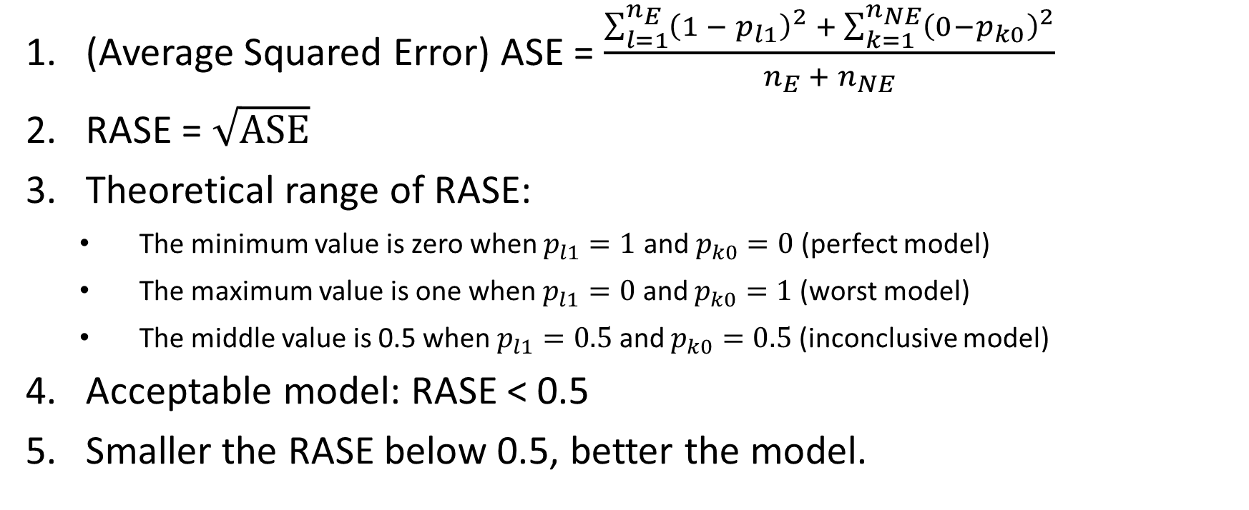
Root Average Squared Error (RASE): Algorithm
(Average Squared Error) ASE = $\frac{\sum_{l=1}^{n_{E}}{{\left({1 − p}_{l1}\right)}^{2} + \sum_{k=1}^{n_{NE}}{{\left(0−p_{k0}\right)}^{2}}}}{n_{E} +{ n}_{NE}}$
RASE = $\sqrt{ASE}$
Theoretical range of RASE:
The minimum value is zero when $p_{l1}=1$ and $p_{k0}=0$ (perfect model)
The maximum value is one when $p_{l1}=0$ and $p_{k0}=1$ (worst model)
The middle value is 0.5 when $p_{l1}=0.5$ and $p_{k0}=0.5$ (inconclusive model)
Acceptable model: RASE < 0.5
Smaller the RASE below 0.5, better the model.

Slide 46
Root Average Squared Error (RASE): Example
The Error is (1 – predicted probability) for Event, and is (0 – predicted probability) for Non-Event
The Sum of Squared Error is 2.31
Number of observations is 11
RASE = SQRT(2.31/11) = SQRT(0.21) = 0.4582576 (7 decimals)
Observed Target Value | Predicted Event Probability | Error | Squared Error
Event | 0.3 | 0.7 | 0.49
Event | 0.4 | 0.6 | 0.36
Event | 0.5 | 0.5 | 0.25
Event | 0.7 | 0.3 | 0.09
Event | 0.9 | 0.1 | 0.01
Event | 1 | 0 | 0
Non-Event | 0.2 | -0.2 | 0.04
Non-Event | 0.3 | -0.3 | 0.09
Non-Event | 0.3 | -0.3 | 0.09
Non-Event | 0.5 | -0.5 | 0.25
Non-Event | 0.8 | -0.8 | 0.64
 |  |  | 2.31

Slide 47
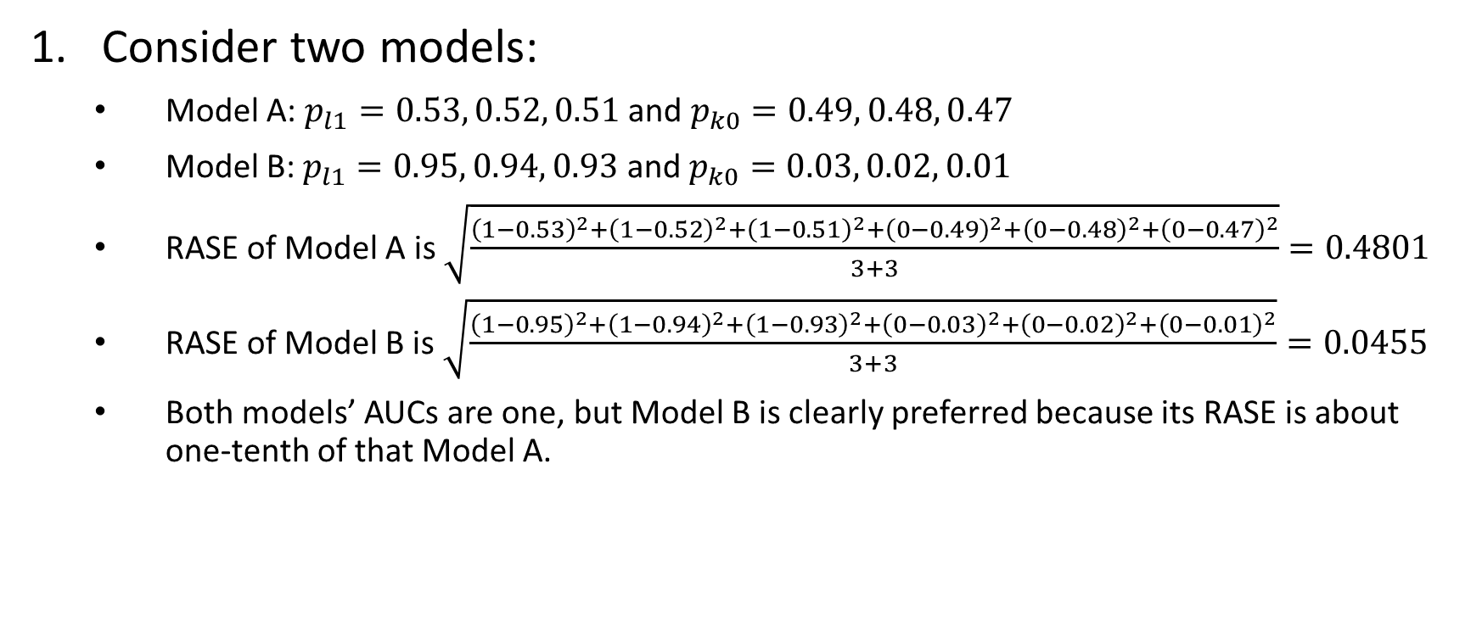
Root Average Squared Error (RASE)
Consider two models:
Model A: $p_{l1}=0.53, 0.52, 0.51$ and $p_{k0}=0.49, 0.48, 0.47$
Model B: $p_{l1}=0.95, 0.94, 0.93$ and $p_{k0}=0.03, 0.02, 0.01$
RASE of Model A is $\sqrt{\frac{{\left(1−0.53\right)}^{2}+{\left(1−0.52\right)}^{2}+{\left(1−0.51\right)}^{2}+{\left(0−0.49\right)}^{2}+{\left(0−0.48\right)}^{2}+{\left(0−0.47\right)}^{2}}{3+3}}=0.4801$
RASE of Model B is $\sqrt{\frac{{\left(1−0.95\right)}^{2}+{\left(1−0.94\right)}^{2}+{\left(1−0.93\right)}^{2}+{\left(0−0.03\right)}^{2}+{\left(0−0.02\right)}^{2}+{\left(0−0.01\right)}^{2}}{3+3}}=0.0455$
Both models’ AUCs are one, but Model B is clearly preferred because its RASE is about one-tenth of that Model A.

Slide 48
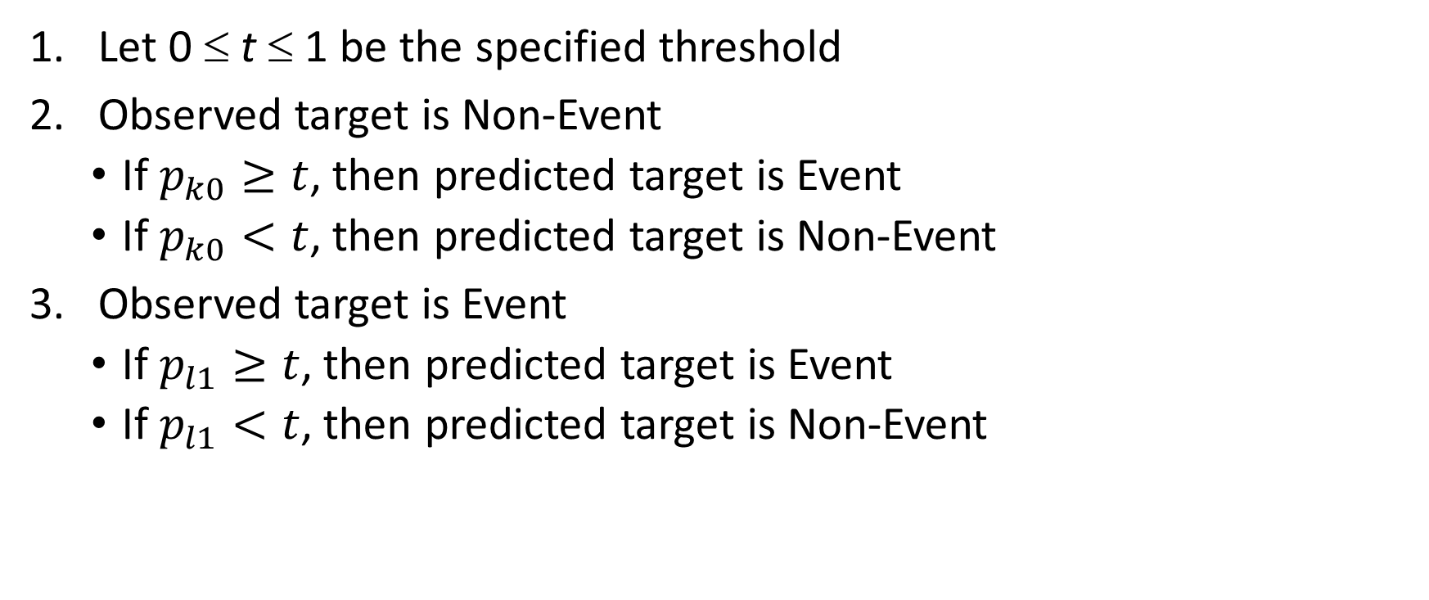
Misclassification Rate
Let 0 ≤ t ≤ 1 be the specified threshold
Observed target is Non-Event
If $p_{k0}≥t$, then predicted target is Event
If $p_{k0}<t$, then predicted target is Non-Event
Observed target is Event
If $p_{l1}≥t$, then predicted target is Event
If $p_{l1}<t$, then predicted target is Non-Event

Slide 49
Misclassification Rate
An observation is misclassified if the observed target value is not equal to the predicted target value
For a binary target, the conditions for misclassification are:
Observed Target = Event & Predicted Target = Non-Event
Observed Target = Non-Event & Predicted Target = Event
Misclassification Rate = (Number of misclassified observations) / (Total number of observations)
Express Misclassification Rate as either a fraction or a percentage

Slide 50
Misclassification Rate
Perfect Model: 0% misclassification rate
Worst Model: 100% misclassification rate
A common choice for threshold 0 ≤ t ≤ 1
The observed proportion of a particular target category in the training partition or in the entire data
The uninformative value of 1 / k where k is the number of target categories

Slide 51
Misclassification Rate
Use the Uninformative Threshold of 0.5
Predicted Event if Predicted Event Probability ≥ 0.5
Number of observations is 11
Number of Misclassified observations is 4
Misclassification Rate = 4/11 = 0.3636 (or 36.36%)
Observed Target Value | Predicted Event Probability | Prediction | Misclassified?
Event | 0.3 | Non-Event | 1
Event | 0.4 | Non-Event | 1
Event | 0.5 | Event | 0
Event | 0.7 | Event | 0
Event | 0.9 | Event | 0
Event | 1 | Event | 0
Non-Event | 0.2 | Non-Event | 0
Non-Event | 0.3 | Non-Event | 0
Non-Event | 0.3 | Non-Event | 0
Non-Event | 0.5 | Event | 1
Non-Event | 0.8 | Event | 1
 |  |  | 4

Slide 52
Misclassification Rate
Observed proportion of Event = 6 / (6 + 5) = 0.54
Predicted Event if Predicted Event Probability ≥ 0.54
Number of observations is 11
Number of Misclassified observations is 4
Misclassification Rate = 4/11 = 0.3636 (or 36.36%)
Observed Target Value | Predicted Event Probability | Prediction | Misclassified?
Event | 0.3 | Non-Event | 1
Event | 0.4 | Non-Event | 1
Event | 0.5 | Non-Event | 1
Event | 0.7 | Event | 0
Event | 0.9 | Event | 0
Event | 1 | Event | 0
Non-Event | 0.2 | Non-Event | 0
Non-Event | 0.3 | Non-Event | 0
Non-Event | 0.3 | Non-Event | 0
Non-Event | 0.5 | Non-Event | 0
Non-Event | 0.8 | Event | 1
 |  |  | 4

Slide 53
Model Assessment Example
Observed Target Value | Predicted Event Probability
Event | 0.9
Non-Event | 0.5
Non-Event | 0.3
Event | 0.7
Event | 0.3
Non-Event | 0.8
Event | 0.4
Non-Event | 0.2
Event | 1.0
Event | 0.5
Non-Event | 0.3
AUC = 0.75
RASE = 0.4582576
Misclassification Rate = 0.3636363 (threshold = 0.5 and 0.54)
Based on these three metrics, the model fits the data adequately
Week 8 Evaluation.py

Slide 54
Model Assessment Example
import matplotlib.pyplot as plt
import numpy
import sklearn.metrics as metrics
Y = numpy.array(['Event',
'Non-Event',
'Non-Event',
'Event',
'Event',
'Non-Event',
'Event',
'Non-Event',
'Event',
'Event',
'Non-Event'])
nY = Y.shape[0]
predProbY = numpy.array([0.9,0.5,0.3,0.7,0.3,0.8,0.4,0.2,1,0.5,0.3])

Slide 55
Model Assessment Example
# Determine the predicted class of Y
predY = numpy.empty_like(Y)
for i in range(nY):
if (predProbY[i] > 0.5):
predY[i] = 'Event'
else:
predY[i] = 'Non-Event'
# Calculate the Root Average Squared Error
RASE = 0.0
for i in range(nY):
if (Y[i] == 'Event'):
RASE += (1 - predProbY[i])**2
else:
RASE += (0 - predProbY[i])**2
RASE = numpy.sqrt(RASE/nY)
# Calculate the Root Mean Squared Error
Y_true = 1.0 * numpy.isin(Y, ['Event’])
RMSE = metrics.mean_squared_error(Y_true, predProbY)
RMSE = numpy.sqrt(RMSE)
Make ‘Event’ into True and finally to 1.
Otherwise, into False and finally to 0.

Slide 56
Model Assessment Example
# For binary y_true, y_score is supposed to be the score of the class with greater label.
AUC = metrics.roc_auc_score(Y_true, predProbY)
accuracy = metrics.accuracy_score(Y, predY)
print(' Accuracy: {:.13f}' .format(accuracy))
print(' Misclassification Rate: {:.13f}' .format(1-accuracy))
print(' Area Under Curve: {:.13f}' .format(AUC))
print('Root Average Squared Error: {:.13f}' .format(RASE))
print(' Root Mean Squared Error: {:.13f}' .format(RMSE))
------ Results ------
Accuracy: 0.6363636363636
Misclassification Rate: 0.3636363636364
Area Under Curve: 0.7500000000000
Root Average Squared Error: 0.4582575694956
Root Mean Squared Error: 0.4582575694956

Slide 57
Common Metric for Nominal Target
Root Average Squared Error
Misclassification Rate
Define a rule to pick the predicted target category (e.g., the lexically lowest category which has the highest predicted probability)
An observation is misclassified if the predicted target category is different from the observed target category.
Calculate the percents of observations that are misclassified.

Slide 58
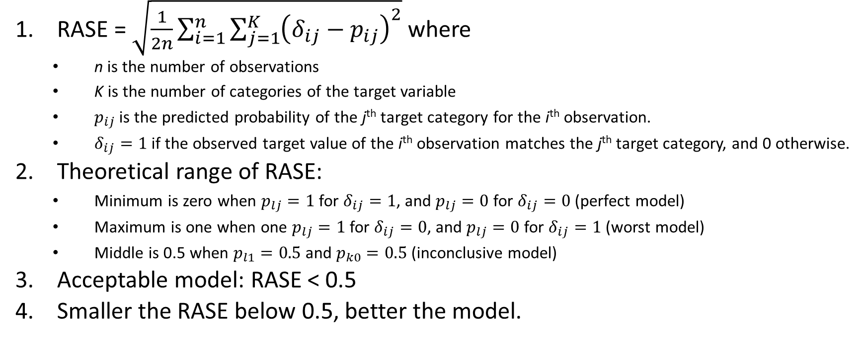
Root Average Squared Error (RASE): Algorithm
RASE = $\sqrt{\frac{1}{2n}\sum_{i=1}^{n}{\sum_{j=1}^{K}{{\left(δ_{ij}−p_{ij}\right)}^{2}}}}$ where
n is the number of observations
K is the number of categories of the target variable
$p_{ij}$ is the predicted probability of the j^{th} target category for the i^{th} observation.
$δ_{ij}=1$ if the observed target value of the i^{th} observation matches the j^{th} target category, and 0 otherwise.
Theoretical range of RASE:
Minimum is zero when $p_{lj}=1$ for $δ_{ij}=1$, and $p_{lj}=0$ for $δ_{ij}=0$ (perfect model)
Maximum is one when one $p_{lj}=1$ for $δ_{ij}=0$, and $p_{lj}=0$ for $δ_{ij}=1$ (worst model)
Middle is 0.5 when $p_{l1}=0.5$ and $p_{k0}=0.5$ (inconclusive model)
Acceptable model: RASE < 0.5
Smaller the RASE below 0.5, better the model.

Slide 59
ROC Curve for Binary Target: Introduction
Next is to introduce the “Curve” in the “Area Under Curve”.
The “Curve” is the Receiver Operating Characteristics (ROC) curve
ROC curves were developed in the 1950s as a by-product of research into making sense of radio signals contaminated by noise
Following the attack on Pearl Harbor, the United States army began new research to increase the prediction of correctly detected Japanese aircraft from their radar signals
False Positive leads to weapon fire on airplanes from one's own side
False Negative leads to an actual enemy attack

Slide 60
ROC Curve: Motivations
If my model actually works, then observations will be predicted an Event when the observed target value is actually Event.
If an Event is predicted when the predicted probability is greater than or equal to the threshold, then we can create this table:
 | Predicted Non-Event | Predicted Event | Total Observed
Observed Non-Event | A (true negative) | B (false positive) | A+B
Observed Event | C (false negative) | D (true positive) | C+D
Total Predicted | A+C | B+D | A+B+C+D

Slide 61
ROC Curve: Motivations
 | Predicted Non-Event | Predicted Event | Total Observed
Observed Non-Event | A (true negative) | B (false positive) | A+B
Observed Event | C (false negative) | D (true positive) | C+D
Total Predicted | A+C | B+D | A+B+C+D
Sensitivity (true positive) = 100% * (D / (C + D))
Specificity (true negative) = 100% * (A / (A + B)) or 1 – Specificity (false positive) = 100% * (B / (A + B))
When the threshold goes down, then True Positive increases but False Positive also increases.
When the threshold goes up, then False Positive decreases but True Positive also decreases.
Show the relationship between True Positive and False Positive for all possible thresholds?

Slide 62
ROC Curve: Construction
Create a set of distinct predicted probabilities
For example, the event predicted probabilities are {0.1, 0.1, 0.5, 0.8, 0.9, 0.9} then this set is {0.1, 0.5, 0.8, 0.9}
Use each element of this set as a cut-off to assign each observation into Predicted Event and Predicted Non-Event
A predicted event is Predicted Probability ≥ Cut-Off
If cut-off is 0.5, then the predictions are: {NE, NE, E, E, E, E} where NE = Non-Event and E = Event
Calculate the ROC Curve coordinates:
(y-Axis): Sensitivity (true positive) = 100% * (D / (C + D))
(x-Axis): 1 – Specificity (false positive) = 100% * (B / (A + B))

Slide 63
ROC Curve: Example
Binary target variable, values are Event and Non-Event.
The table (on the right) contains the observed target value and the predicted event probabilities.
Sort the Predicted Event Probability in ascending order
The set of unique predicted event probabilities are: {0.2, 0.3, 0.4, 0.5, 0.7, 0.8, 0.9, 1.0}.
Use values from this set in turns as the cut-off thresholds
Use each cutoff value to predict Event versus Non-Event
Count the number of True Positives (TP) and the number of True Negatives (TN)
Number of Observed Event = 6
Number of Observed Non-Event = 5
Sensitivity = TP / 6, and 1 – Specificity = 1 – TN / 5
Observed Target Value | Predicted Event Probability
Event | 0.9
Non-Event | 0.5
Non-Event | 0.3
Event | 0.7
Event | 0.3
Non-Event | 0.8
Event | 0.4
Non-Event | 0.2
Event | 1.0
Event | 0.5
Non-Event | 0.3

Slide 64
ROC Curve: Example
True Positive: Event
True Negative: Non-Event
Observed Target Value | Predicted Event Probability | Cutoff: 0.2 | Cutoff: 0.3 | Cutoff: 0.4 | Cutoff: 0.5 | Cutoff: 0.7 | Cutoff: 0.8 | Cutoff: 0.9 | Cutoff: 1.0
Non-Event | 0.2 | Event | Non-Event | Non-Event | Non-Event | Non-Event | Non-Event | Non-Event | Non-Event
Event | 0.3 | Event | Event | Non-Event | Non-Event | Non-Event | Non-Event | Non-Event | Non-Event
Non-Event | 0.3 | Event | Event | Non-Event | Non-Event | Non-Event | Non-Event | Non-Event | Non-Event
Non-Event | 0.3 | Event | Event | Non-Event | Non-Event | Non-Event | Non-Event | Non-Event | Non-Event
Event | 0.4 | Event | Event | Event | Non-Event | Non-Event | Non-Event | Non-Event | Non-Event
Event | 0.5 | Event | Event | Event | Event | Non-Event | Non-Event | Non-Event | Non-Event
Non-Event | 0.5 | Event | Event | Event | Event | Non-Event | Non-Event | Non-Event | Non-Event
Event | 0.7 | Event | Event | Event | Event | Event | Non-Event | Non-Event | Non-Event
Non-Event | 0.8 | Event | Event | Event | Event | Event | Event | Non-Event | Non-Event
Event | 0.9 | Event | Event | Event | Event | Event | Event | Event | Non-Event
Event | 1.0 | Event | Event | Event | Event | Event | Event | Event | Event
Cutoff | 0.2 | 0.3 | 0.4 | 0.5 | 0.7 | 0.8 | 0.9 | 1
# TP | 6 | 6 | 5 | 4 | 3 | 2 | 2 | 1
# TN | 0 | 1 | 3 | 3 | 4 | 4 | 5 | 5
Sensitivity | 1.00 | 1.00 | 0.83 | 0.67 | 0.50 | 0.33 | 0.33 | 0.17
1 – Specificity | 1.00 | 0.80 | 0.40 | 0.40 | 0.20 | 0.20 | 0.00 | 0.00

Slide 65
ROC Curve: Example
Since the ROC Curve conventionally includes the coordinates (0,0) and (1,1), you may need to add these two points if they are not there.
Cutoff | 0.2 | 0.3 | 0.4 | 0.5 | 0.7 | 0.8 | 0.9 | 1
# TP | 6 | 6 | 5 | 4 | 3 | 2 | 2 | 1
# TN | 0 | 1 | 3 | 3 | 4 | 4 | 5 | 5
Sensitivity | 1.00 | 1.00 | 0.83 | 0.67 | 0.50 | 0.33 | 0.33 | 0.17
1 – Specificity | 1.00 | 0.80 | 0.40 | 0.40 | 0.20 | 0.20 | 0.00 | 0.00

Slide 66
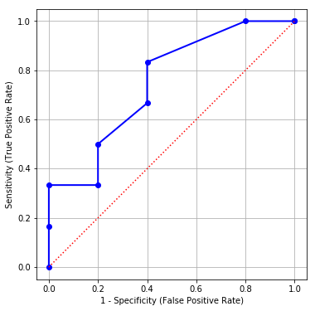
ROC Curve: Example in Week 8 Evaluation.py
# Generate the coordinates for the ROC curve
OneMinusSpecificity, Sensitivity, thresholds = metrics.roc_curve(Y, predProbY, pos_label = 'Event')
# Add two dummy coordinates
OneMinusSpecificity = numpy.append([0], OneMinusSpecificity)
Sensitivity = numpy.append([0], Sensitivity)
OneMinusSpecificity = numpy.append(OneMinusSpecificity, [1])
Sensitivity = numpy.append(Sensitivity, [1])
# Draw the ROC curve
plt.figure(figsize=(6,6))
plt.plot(OneMinusSpecificity, Sensitivity, marker = 'o',
color = 'blue', linestyle = 'solid', linewidth = 2, markersize = 6)
plt.plot([0, 1], [0, 1], color = 'red', linestyle = ':')
plt.grid(True)
plt.xlabel("1 - Specificity (False Positive Rate)")
plt.ylabel("Sensitivity (True Positive Rate)")
ax = plt.gca()
ax.set_aspect('equal')
plt.show()

Slide 67
ROC Curve: Interpretations
If I can tolerate a particular percent of False Positive, then what percent of True Positive I will get?
If I can tolerate up to 10% of False Positive, then I can get up to 33% of True Positive (Sensitivity)
If I can tolerate up to 20% of False Positive, then I can get up to 50% of True Positive
If I want a certain percent of True Positive, then what percent of False Positive do I need to tolerate?
If I want at least 80% of True Positive, then I need to tolerate at least 40% of False Positive (1 – Specificity)
If I want at least 40% of True Positive, then I need to tolerate at least 20% of False Positive

Slide 68
Gain and Lift: Statement of Problem
I have a model to predict a customer’s likelihood to respond to my market campaign.
I have limited resources (e.g., budget, time, personnel).
I should contact the customers who are more likely to respond according to the model (i.e., higher predicted probability to respond).
How should I choose the customers to contact?
What percentage of customers should I contact?
What is the response rate of the customers whom I will contact?

Slide 69
Gain and Lift: Motivations
If my model actually works, then the customers with higher predicted probabilities are more likely to respond than the customers with lower predicted probabilities.
An idea is to put customers into groups of descending predicted probabilities and study the response rates of the groups.
Customers in the first few groups are "more preferred".

Slide 70
Gain and Lift: Algorithm
Calculate the predicted event (e.g., YES) probabilities
Sort the predicted probabilities in descending order
Divide the predicted probabilities into ten deciles
Ideally, the deciles have equal numbers of observations
Decile 1 contains the top 10% of predicted probabilities
Decile 2 contains the next 10% of predicted probabilities
… and so on
Decile 10 contains the bottom 10% of predicted probabilities
Calculate a suite of statistics in each decile

Slide 71
Gain and Lift: Column Statistics
Decile N: Number of cases in the decile
Decile %: Percent of cases in the decile (base = entire sample)
Gain N: Number of cases of the target category in the decile (e.g., target category = Yes)
Gain %: Percent of cases of the target category in the decile with respect to the overall number of cases of the target category
Response %: Percent of cases of the target category in the decile
Lift: Response % divided by the overall percentage of the target category

Slide 72
Gain and Lift: Column Statistics (Accumulated Decile = Lower Deciles + Current Decile)
Accumulated Decile N: Number of cases in the accumulated decile
Accumulated Decile %: Percent of cases in the accumulated decile (base = entire sample)
Accumulated Gain N: Number of cases of the target category in the accumulated decile (e.g., target category = Yes)
Accumulated Gain %: Percent of cases of the target category in the accumulated decile with respect to the overall number of cases of the target category
Accumulated Response %: Percent of cases of the target category in the accumulated decile
Accumulated Lift: Accumulated Response % divided by the overall percent of the target category

Slide 73
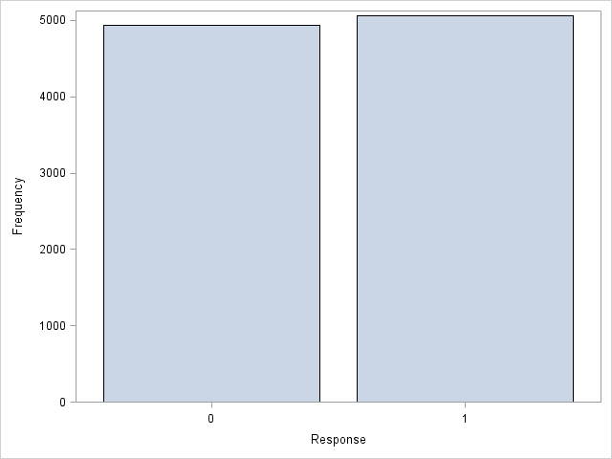
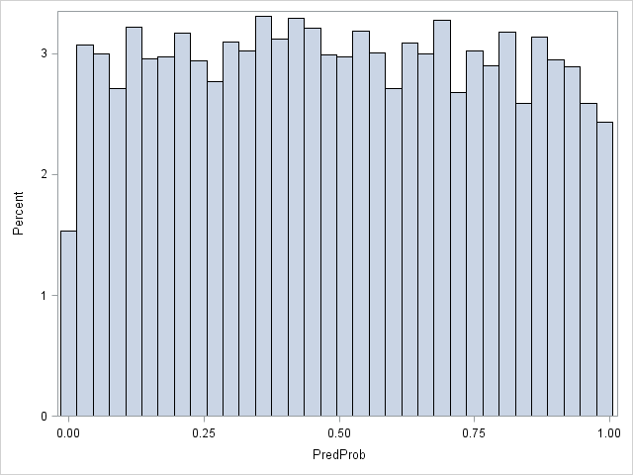
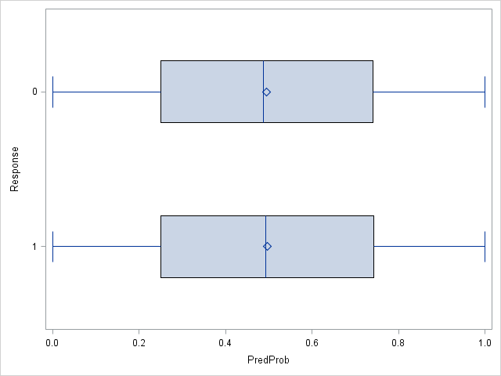
Gain and Lift: Uninformative Model
10,000 observations
Response: generated from a Bernoulli distribution with p = 0.5 (i.e., flipping a fair coin), Response = 1 is the target category
PredProb: predicted probability from a Uniform distribution
Response and PredProb are statistically independent

Slide 74
Gain and Lift: Uninformative Model
Decile | Decile N | Decile % | Gain N | Gain % | Response % | Lift
1 | 1,000 | 10.0% | 505 | 9.98% | 50.50% | 0.998
2 | 1,000 | 10.0% | 498 | 9.84% | 49.80% | 0.984
3 | 1,000 | 10.0% | 508 | 10.04% | 50.80% | 1.004
4 | 1,000 | 10.0% | 521 | 10.30% | 52.10% | 1.030
5 | 1,000 | 10.0% | 514 | 10.16% | 51.40% | 1.016
6 | 1,000 | 10.0% | 486 | 9.60% | 48.60% | 0.960
7 | 1,000 | 10.0% | 504 | 9.96% | 50.40% | 0.996
8 | 1,000 | 10.0% | 524 | 10.36% | 52.40% | 1.036
9 | 1,000 | 10.0% | 493 | 9.74% | 49.30% | 0.974
10 | 1,000 | 10.0% | 507 | 10.02% | 50.70% | 1.002
Overall | 10,000 | 100.0% | 5,060 | 100.00% | 50.60% | 1.000

Slide 75
Gain and Lift: Uninformative Model
50.50% / 50.60% = 0.998
Decile | Decile N | Decile % | Gain N | Gain % | Response % | Lift
1 | 1,000 | 10.0% | 505 | 9.98% | 50.50% | 0.998
2 | 1,000 | 10.0% | 498 | 9.84% | 49.80% | 0.984
3 | 1,000 | 10.0% | 508 | 10.04% | 50.80% | 1.004
4 | 1,000 | 10.0% | 521 | 10.30% | 52.10% | 1.030
5 | 1,000 | 10.0% | 514 | 10.16% | 51.40% | 1.016
6 | 1,000 | 10.0% | 486 | 9.60% | 48.60% | 0.960
7 | 1,000 | 10.0% | 504 | 9.96% | 50.40% | 0.996
8 | 1,000 | 10.0% | 524 | 10.36% | 52.40% | 1.036
9 | 1,000 | 10.0% | 493 | 9.74% | 49.30% | 0.974
10 | 1,000 | 10.0% | 507 | 10.02% | 50.70% | 1.002
Overall | 10,000 | 100.0% | 5,060 | 100.00% | 50.60% | 1.000
505 observations with Response = 1 in Decile 1
505/5060 = 9.98%
505 / 1000 = 50.50% where 1000 is number of observations in Decile 1

Slide 76
Gain and Lift: Uninformative Model
Decile | Acc. Decile N | Acc. Decile % | Acc. Gain N | Acc. Gain % | Acc. Response % | Lift
1 | 1,000 | 10.0% | 505 | 9.98% | 50.50% | 0.998
2 | 2,000 | 20.0% | 1,003 | 19.82% | 50.15% | 0.991
3 | 3,000 | 30.0% | 1,511 | 29.86% | 50.37% | 0.995
4 | 4,000 | 40.0% | 2,032 | 40.16% | 50.80% | 1.004
5 | 5,000 | 50.0% | 2,546 | 50.32% | 50.92% | 1.006
6 | 6,000 | 60.0% | 3,032 | 59.92% | 50.53% | 0.999
7 | 7,000 | 70.0% | 3,536 | 69.88% | 50.51% | 0.998
8 | 8,000 | 80.0% | 4,060 | 80.24% | 50.75% | 1.003
9 | 9,000 | 90.0% | 4,553 | 89.98% | 50.59% | 1.000
10 | 10,000 | 100.0% | 5,060 | 100.00% | 50.60% | 1.000
Overall | 10,000 | 100.0% | 5,060 | 100.00% | 50.60% | 1.000

Slide 77
Gain and Lift: Uninformative Model
For a random model (i.e., predicted and observed values are uncorrelated), lift and accumulated lift values hover around 1.
Suppose all target categories are observed in 10% of data and, in the perfect case, also in Decile 1. Then Lift is ten in Decile 1 and zero in other Deciles.
Let N = no. of observations and N_{T} = no. observations with target category
Decile 1: Decile N = N/10, Gain N = N_{T}, Gain % = 100%, Response % = N_{T} / (N/10), and Lift = (N_{T} / (N/10)) / (N_{T} / N) = 10
Decile 2 to 10: Decile N = 0, Gain N = 0, Gain % = 0%, Response % = 0%, and Lift = 0.
Suppose all target categories are observed in 10% of data and, in the worst case, also in Decile 10. Then Lift is ten in Decile 10 and zero in other Deciles.

Slide 78
The compute_lift_coordinates Function
def compute_lift_coordinates (
DepVar, # The column that holds the dependent variable's values
EventValue, # Value of the dependent variable that indicates an event
EventPredProb, # The column that holds the predicted event probability
Debug = 'N'): # Show debugging information (Y/N)

Slide 79
Example: Week 8 Lift Curve.py
# Read the HMEQ data
hmeq = pandas.read_csv('C:\\Users\\minlam\\Documents\\IIT\\Machine Learning\\Data\\hmeq.csv',
delimiter=',', usecols = ['BAD', 'DEBTINC', 'DELINQ', 'DEROG’])
hmeq = hmeq.dropna()
# Partition the data
hmeq_train, hmeq_test = train_test_split(hmeq, test_size = 0.3, random_state = 60616, stratify = hmeq['BAD'])
# Build a logistic model using the training partition
y_train = hmeq_train['BAD'].astype('category')
X_train = hmeq_train[['DEBTINC', 'DELINQ', 'DEROG']]
X_train = stats.add_constant(X_train, prepend=True)
logit = stats.MNLogit(y_train, X_train)
print("Name of Target Variable:", logit.endog_names)
print("Name(s) of Predictors:", logit.exog_names)
thisFit = logit.fit(maxiter = 100)
thisParameter = thisFit.params
print("Model Parameter Estimates:\n", thisFit.params)
print("Model Log-Likelihood Value:\n", logit.loglike(thisParameter.values)

Slide 80
Logistic Model Results
Optimization terminated successfully.
Current function value: 0.251262
Iterations 7
Model Parameter Estimates:
0
const -6.342381
DEBTINC 0.099627
DELINQ 0.763212
DEROG 0.640403
Model Log-Likelihood Value:
-712.3275144387453

Slide 81
Score the Training Partition
y_train_predProb = thisFit.predict(X_train)
score_train = pandas.concat([y_train, y_train_predProb], axis = 1)
# Get the Lift chart coordinates
lift_coordinates, acc_lift_coordinates = compute_lift_coordinates (
DepVar = score_train['BAD'],
EventValue = 1,
EventPredProb = score_train[1],
Debug = 'Y')

Slide 82
Lift Chart for the Training Partition
Decile | Decile N | Decile % | Gain N | Gain % | Response % | Lift
1 | 284 | 10.02 | 118 | 44.70 | 41.55 | 4.46
2 | 283 | 9.98 | 38 | 14.39 | 13.43 | 1.44
3 | 284 | 10.02 | 20 | 7.58 | 7.04 | 0.76
4 | 283 | 9.98 | 7 | 2.65 | 2.47 | 0.27
5 | 283 | 9.98 | 22 | 8.33 | 7.77 | 0.83
6 | 284 | 10.02 | 14 | 5.30 | 4.93 | 0.53
7 | 283 | 9.98 | 11 | 4.17 | 3.89 | 0.42
8 | 284 | 10.02 | 19 | 7.20 | 6.69 | 0.72
9 | 283 | 9.98 | 6 | 2.27 | 2.12 | 0.23
10 | 284 | 10.02 | 9 | 3.41 | 3.17 | 0.34
Decile | Acc. Decile N | Acc. Decile % | Acc. Gain N | Acc. Gain % | Acc. Response % | Acc. Lift
1 | 284 | 10.02 | 118 | 44.70 | 41.55 | 4.46
2 | 567 | 20.00 | 156 | 59.09 | 27.51 | 2.95
3 | 851 | 30.02 | 176 | 66.67 | 20.68 | 2.22
4 | 1134 | 40.00 | 183 | 69.32 | 16.14 | 1.73
5 | 1417 | 49.98 | 205 | 77.65 | 14.47 | 1.55
6 | 1701 | 60.00 | 219 | 82.95 | 12.87 | 1.38
7 | 1984 | 69.98 | 230 | 87.12 | 11.59 | 1.24
8 | 2268 | 80.00 | 249 | 94.32 | 10.98 | 1.18
9 | 2551 | 89.98 | 255 | 96.59 | 10.00 | 1.07
10 | 2835 | 100.00 | 264 | 100.00 | 9.31 | 1.00

Slide 83
Score the Testing Partition
# Score the test partition
y_test = hmeq_test['BAD'].astype('category')
X_test = hmeq_test[['DEBTINC', 'DELINQ', 'DEROG']]
X_test = stats.add_constant(X_test, prepend=True)
y_test_predProb = thisFit.predict(X_test)
score_test = pandas.concat([y_test, y_test_predProb], axis = 1)
# Get the Lift chart coordinates
lift_coordinates, acc_lift_coordinates = compute_lift_coordinates (
DepVar = score_test['BAD'],
EventValue = 1,
EventPredProb = score_test[1],
Debug = 'Y')

Slide 84
Lift Chart for the Testing Partition
Decile | Decile N | Decile % | Gain N | Gain % | Response % | Lift
1 | 122 | 10.03 | 49 | 43.36 | 40.16 | 4.32
2 | 121 | 9.95 | 15 | 13.27 | 12.40 | 1.33
3 | 122 | 10.03 | 7 | 6.19 | 5.74 | 0.62
4 | 121 | 9.95 | 3 | 2.65 | 2.48 | 0.27
5 | 122 | 10.03 | 4 | 3.54 | 3.28 | 0.35
6 | 121 | 9.95 | 6 | 5.31 | 4.96 | 0.53
7 | 122 | 10.03 | 7 | 6.19 | 5.74 | 0.62
8 | 121 | 9.95 | 5 | 4.42 | 4.13 | 0.44
9 | 122 | 10.03 | 7 | 6.19 | 5.74 | 0.62
10 | 122 | 10.03 | 10 | 8.85 | 8.20 | 0.88
Decile | Acc. Decile N | Acc. Decile % | Acc. Gain N | Acc. Gain % | Acc. Response % | Acc. Lift
1 | 122 | 10.03 | 49 | 43.36 | 40.16 | 4.32
2 | 243 | 19.98 | 64 | 56.64 | 26.34 | 2.83
3 | 365 | 30.02 | 71 | 62.83 | 19.45 | 2.09
4 | 486 | 39.97 | 74 | 65.49 | 15.23 | 1.64
5 | 608 | 50.00 | 78 | 69.03 | 12.83 | 1.38
6 | 729 | 59.95 | 84 | 74.34 | 11.52 | 1.24
7 | 851 | 69.98 | 91 | 80.53 | 10.69 | 1.15
8 | 972 | 79.93 | 96 | 84.96 | 9.88 | 1.06
9 | 1094 | 89.97 | 103 | 91.15 | 9.41 | 1.01
10 | 1216 | 100.00 | 113 | 100.00 | 9.29 | 1.00

Slide 85
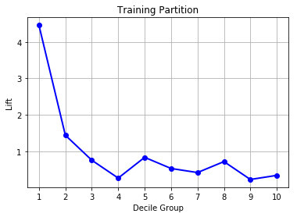
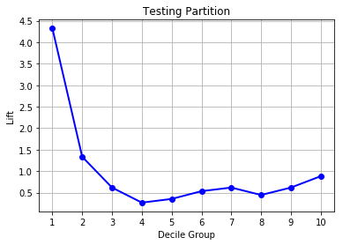
Lift Chart for Both Partitions

Slide 86
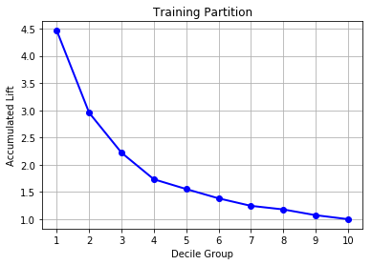
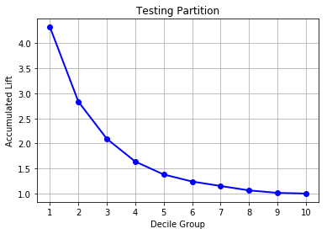
Accumulative Lift Chart for Both Partitions

Slide 87
Interpretation of Testing Partition
If we only contact the top 10.03% of customers, then 40.16% of them will respond BAD = 1. This rate is 4.32 times the overall rate.
If we only contact the next 9.95% of customers, then 12.40% of them will respond BAD = 1. This rate is 1.33 times the overall rate.
Decile | Decile N | Decile % | Gain N | Gain % | Response % | Lift
1 | 122 | 10.03 | 49 | 43.36 | 40.16 | 4.32
2 | 121 | 9.95 | 15 | 13.27 | 12.40 | 1.33
3 | 122 | 10.03 | 7 | 6.19 | 5.74 | 0.62
4 | 121 | 9.95 | 3 | 2.65 | 2.48 | 0.27
5 | 122 | 10.03 | 4 | 3.54 | 3.28 | 0.35
6 | 121 | 9.95 | 6 | 5.31 | 4.96 | 0.53
7 | 122 | 10.03 | 7 | 6.19 | 5.74 | 0.62
8 | 121 | 9.95 | 5 | 4.42 | 4.13 | 0.44
9 | 122 | 10.03 | 7 | 6.19 | 5.74 | 0.62
10 | 122 | 10.03 | 10 | 8.85 | 8.20 | 0.88

Slide 88
Interpretation of Testing Partition
If we only contact the top 10.03% of customers, then 40.26% of them will respond BAD = 1. This rate is 4.32 times the overall rate.
If we only contact the top 19.98% of customers, then 26.34% of them will respond BAD = 1. This rate is 2.83 times the overall rate.
Decile | Acc. Decile N | Acc. Decile % | Acc. Gain N | Acc. Gain % | Acc. Response % | Acc. Lift
1 | 122 | 10.03 | 49 | 43.36 | 40.16 | 4.32
2 | 243 | 19.98 | 64 | 56.64 | 26.34 | 2.83
3 | 365 | 30.02 | 71 | 62.83 | 19.45 | 2.09
4 | 486 | 39.97 | 74 | 65.49 | 15.23 | 1.64
5 | 608 | 50.00 | 78 | 69.03 | 12.83 | 1.38
6 | 729 | 59.95 | 84 | 74.34 | 11.52 | 1.24
7 | 851 | 69.98 | 91 | 80.53 | 10.69 | 1.15
8 | 972 | 79.93 | 96 | 84.96 | 9.88 | 1.06
9 | 1094 | 89.97 | 103 | 91.15 | 9.41 | 1.01
10 | 1216 | 100.00 | 113 | 100.00 | 9.29 | 1.00

Slide 89
Interpretation of Testing Partition
If we only review top 19.98% of loan applications which are predicted with high likelihoods to default, then we can capture 56.64% of all the loans that eventually default. The default rate of this top 19.98% pool is 26.34% which is 2.83 times the overall rate.
Decile | Acc. Decile N | Acc. Decile % | Acc. Gain N | Acc. Gain % | Acc. Response % | Acc. Lift
1 | 122 | 10.03 | 49 | 43.36 | 40.16 | 4.32
2 | 243 | 19.98 | 64 | 56.64 | 26.34 | 2.83
3 | 365 | 30.02 | 71 | 62.83 | 19.45 | 2.09
4 | 486 | 39.97 | 74 | 65.49 | 15.23 | 1.64
5 | 608 | 50.00 | 78 | 69.03 | 12.83 | 1.38
6 | 729 | 59.95 | 84 | 74.34 | 11.52 | 1.24
7 | 851 | 69.98 | 91 | 80.53 | 10.69 | 1.15
8 | 972 | 79.93 | 96 | 84.96 | 9.88 | 1.06
9 | 1094 | 89.97 | 103 | 91.15 | 9.41 | 1.01
10 | 1216 | 100.00 | 113 | 100.00 | 9.29 | 1.00

Slide 90
Model Evaluation: Final Remarks
If my goal is to get a model that fits the entire dataset well, then I will consider the Area Under Curve statistic, the Misclassification Rate, the Root Average Squared Error, the ROC Curve
If my goal is to get a model that fits a portion of the dataset (usually your top customers) well, then I will consider the Gain and the Lift

Slide 91
Model Comparison: Key Takeaway
When we compare the results of several algorithms, we should only look at metrics that are calculated using the Test partition.
Higher Area Under Curve (binary target)
Higher Lift in the first few deciles (binary target)
Lower Root Average Squared Error (interval, binary, and nominal target)
Lower Misclassification Rate (binary and nominal target)
Lower Relative Error (interval target)

Slide 92
Mid-Term Test
This is an open-book take home test.
The questions will be available on Blackboard from 12:01 am on Wednesday, March 27, 2019.
The deadline to submit your answers is 11:59 pm on Tuesday, April 2, 2019.

